Slide 1

Sustainability
& innovation

Slide 2
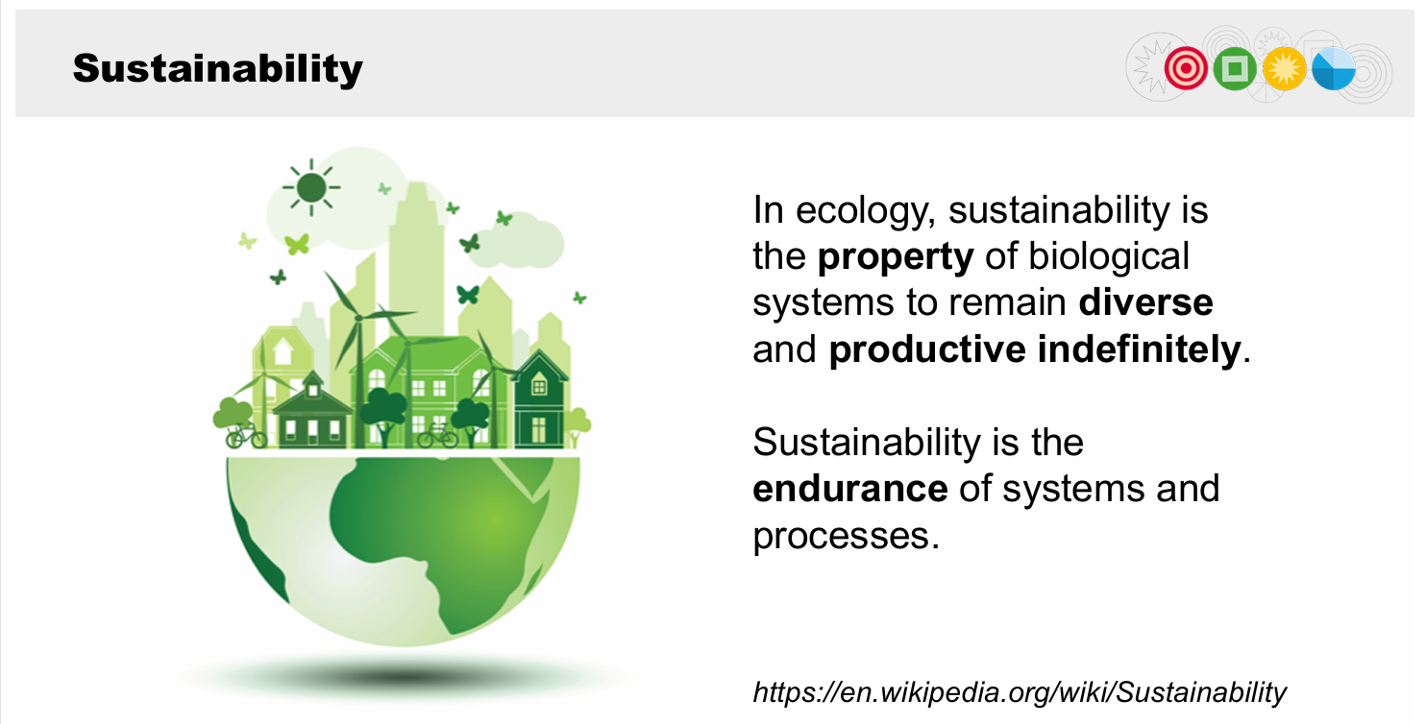
https://www.youtube.com/watch?v=li0EpfSbOJg&t=37s

Slide 3
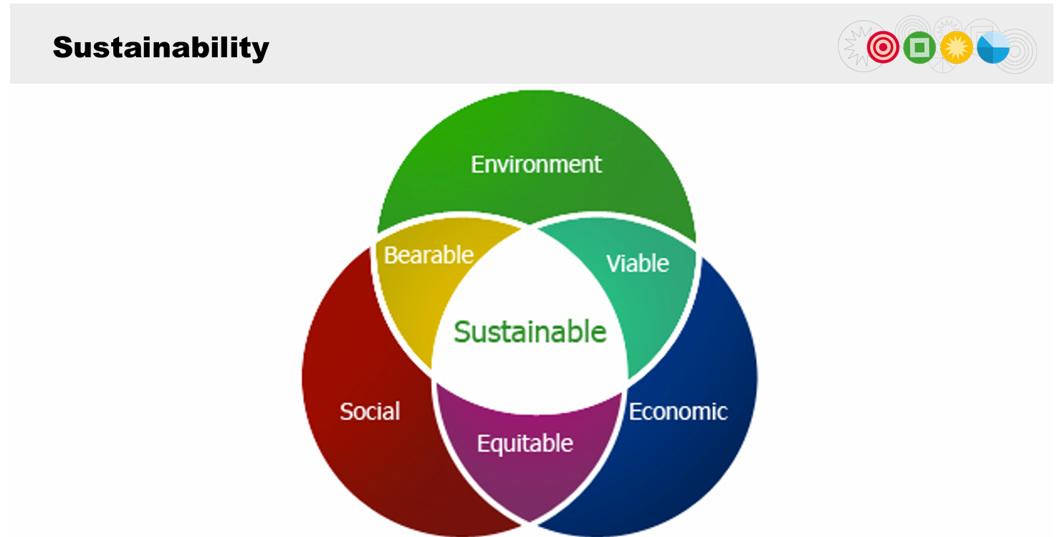

Slide 4
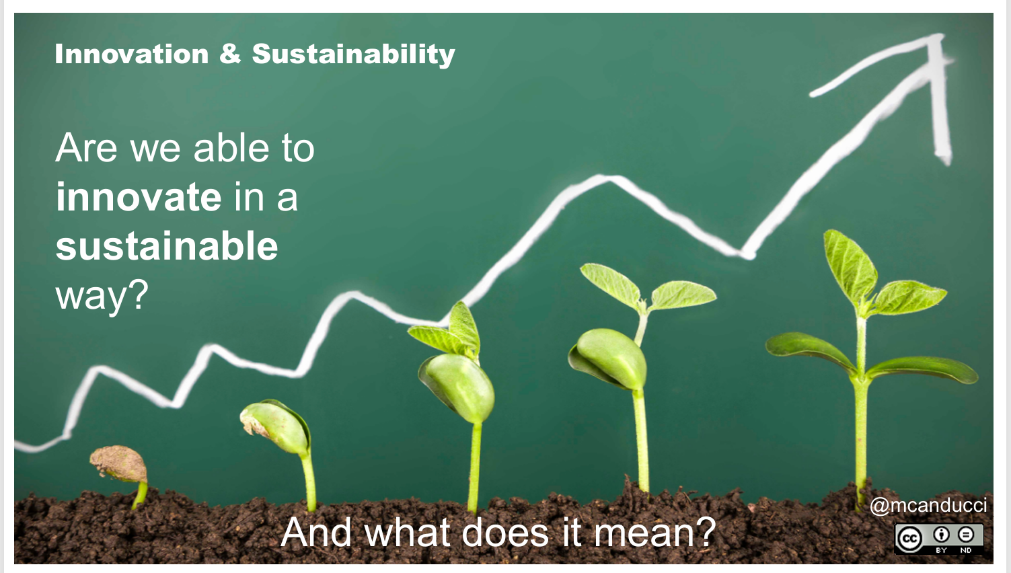

Slide 5
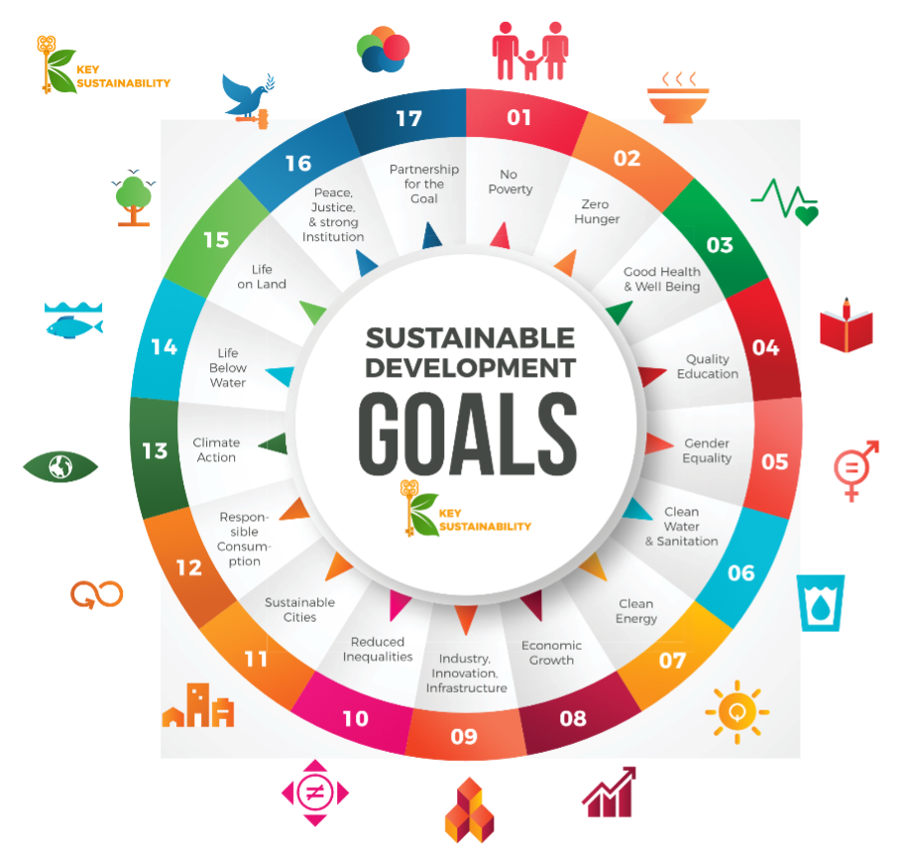

Slide 6
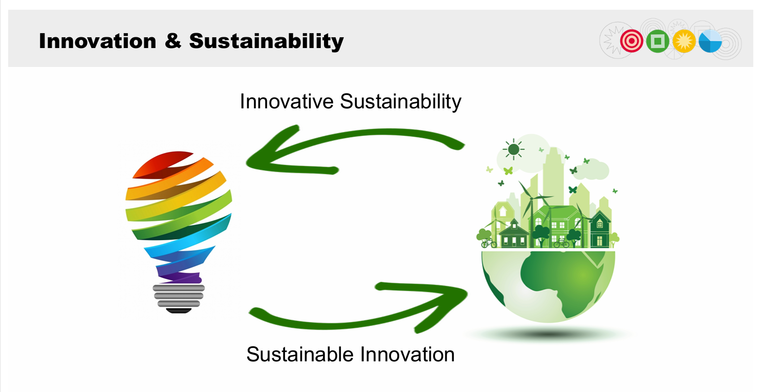
https://www.youtube.com/watch?v=jfsWI8XgQyo

Slide 7
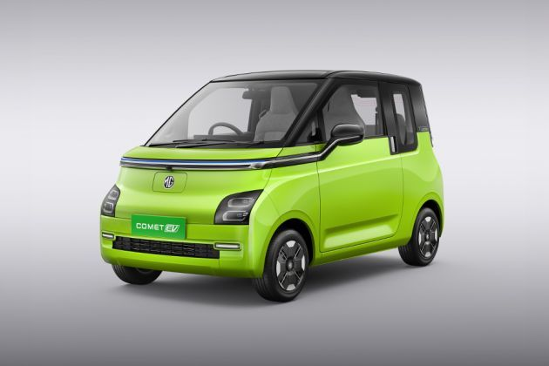
Are Electric Cars Sustainable?
Sometimes, lithium-ion batteries (LIBs) applications are labeled as “zero emissions.”
However, the emissions generated in the procurement and production stages of the supply chain are not considered.
Battery production is one of the main contributors to emitting greenhouse gas (GHG) emissions through electric vehicle (EV) manufacturing.
In this case, recycling of LIBs is recommended to reduce energy consumption and mitigate GHG emissions as well as result in considerable natural resource savings compared to landfills.
https://www.youtube.com/watch?v=fpwAuIXtPgw

Slide 8
Is block chain technology sustainable ?
The Bitcoin energy consumption index is rising primarily because more miners are joining the network,
leading to increased computational power needed to solve complex cryptographic puzzles to mine new bitcoins,
which translates to higher energy consumption as more mining machines are operating simultaneously to compete for rewards;
this phenomenon is amplified when the price of Bitcoin increases, incentivizing more miners to participate

Slide 9
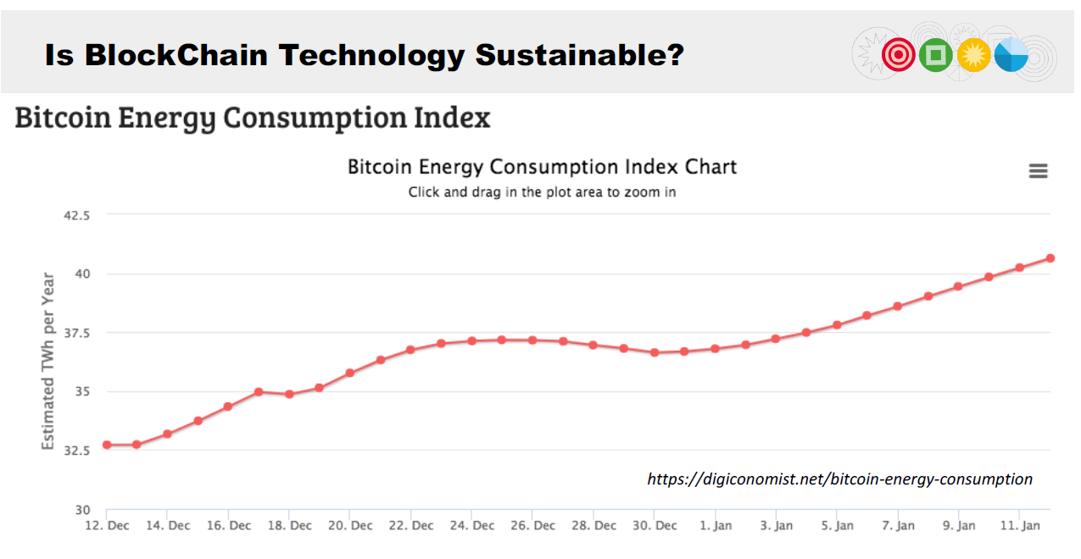

Slide 10
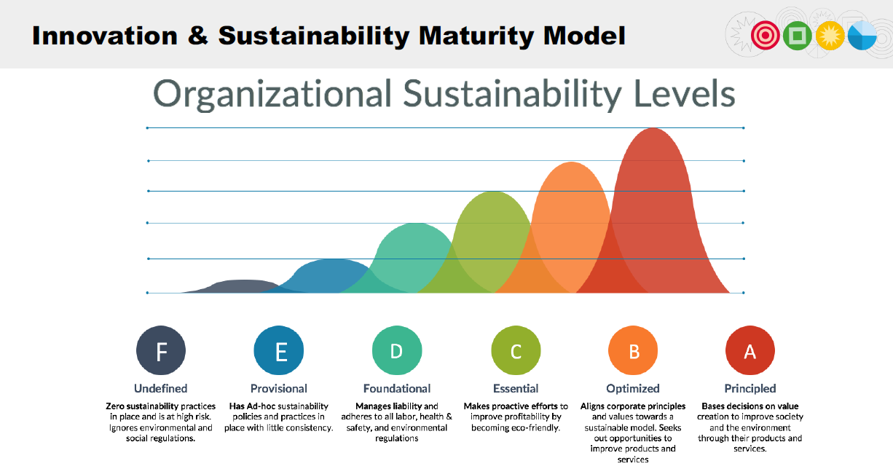

Slide 11
Tips for sustainability-driven innovations
When you innovate, Consider Sustainability
When you work on sustainability, be innovative
Technology is not enough
Focus on +20 years, not on today
Do not forget you are changing the world, leave it better than you found it
https://www.youtube.com/watch?v=-ImeCnh3iNA

